Slide 1
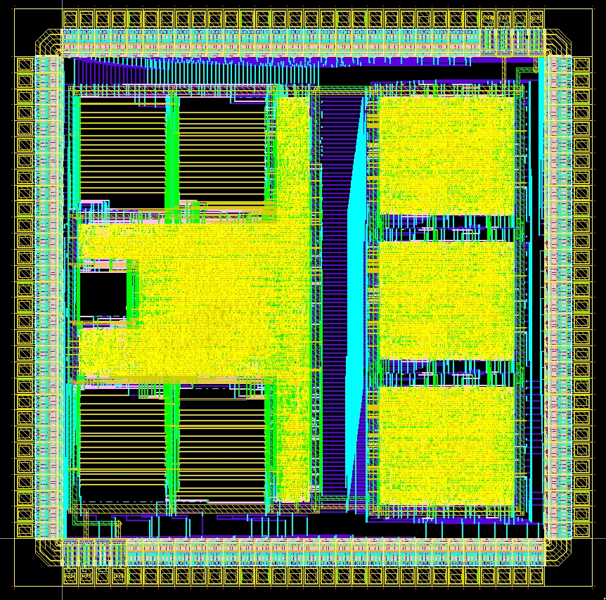
Digital Systems and Microprocessor Design (H7068)
9.3. Assembler memory access
Daniel Roggen
d.roggen@sussex.ac.uk

Slide 2
Content
Memory interface
Memory read move instructions
Memory write move instructions
Mapping between C pointers and assembler instructions

Slide 3
Memory interface
The educational processor has a memory interface allowing to read or write data from memory (or do nothing with it).
Von Neumann architecture: the memory can contain code or data.
When and how is the memory used?
During fetch cycles:
  The processor reads from memory two bytes (one byte during fetchh and one during fetchl cycles). This is the instruction to execute.
During the execute cycle:
  The memory is unused if the instruction is not a mov to/from memory
  If the instruction is a mov to memory: one byte is written to the destination address
  If the instruction is a mov from memory: one byte is read from the source address

Slide 4
Memory interface
The UoS processor is connected to the RAM with the following lines:
  ram_we (1 bit, processor output): indicates to write the data on ram_datawr to address ram_address at the next rising edge
  ram_address (5 bits, processor output): indicates the RAM address to which to write and from which to read
  ram_datawr (8 bits, processor output): indicates the byte to write
  ram_datard (8 bits, processor input): the byte at address ram_address
ram_we
we
ram_address
5
address
ram_datawr
8
data
ram_datard
8
q
clk
Processor
RAM

Slide 5
Memory
Remember a memory is akin to a table where data can be stored at an address
The memory implemented alongside the UoS processor on the FPGA has the following characteristic:
  Synchronous write: it writes “data” to “address” when “we=1” at the next clock rising edge
  Asynchronous read: “q” is the data at “address”; changing the address gives immediately (after the propagation time) the data at this address
Address Data
00 ??
01 ??
02 ??
03 ??
04 ??
RAM

Slide 6
Memory
On reset the program counter PC=0. Therefore the program starts at address 0, and the first instruction executed on reset is at address 0.
Address Data
00 ??
01 ??
02 ??
03 ??
04 ??
First instruction executed on reset.
RAM

Slide 7

Accessing the memory
In the UoS processor, the memory can only be accessed by “mov” instruction
Reminder: mov dst, src
Instructions | instruction(15..8) |  |  |  |  |  |  |  | Instruction(7..0)
Move | Opcode |  |  |  | dd#m | sd#m | dreg (rn) |  | src (i or rm)
mov rn, rm | 0 | 0 | 0 | 0 | 0 | 0 | r | r | - | - | - | - | - | - | r | r
mov rn, i | 0 | 0 | 0 | 1 | 0 | 0 | r | r | i | i | i | i | i | i | i | i
mov rn, [rm] | 0 | 0 | 0 | 0 | 0 | 1 | r | r | - | - | - | - | - | - | r | r
mov rn, [i] | 0 | 0 | 0 | 1 | 0 | 1 | r | r | i | i | i | i | i | i | i | i
mov [rn], rm | 0 | 0 | 0 | 0 | 1 | 0 | r | r | - | - | - | - | - | - | r | r
mov [rn], i | 0 | 0 | 0 | 1 | 1 | 0 | r | r | i | i | i | i | i | i | i | i

Slide 8
Reading data from a memory location
Move from memory location can be done with immediate or register address.
Immediate address: mov ra,[07h]
  Reads the data at address 07h and puts it into register ra
Register address: mov ra,[rb]
  Reads the data at address rb and puts it into register ra.
  For example, if rb=09, it reads data at address 09 and puts it into ra
Instructions | instruction(15..8) |  |  |  |  |  |  |  | Instruction(7..0)
Move | Opcode |  |  |  | dd#m | sd#m | dreg (rn) |  | src (i or rm)
mov rn, [rm] | 0 | 0 | 0 | 0 | 0 | 1 | r | r | - | - | - | - | - | - | r | r
mov rn, [i] | 0 | 0 | 0 | 1 | 0 | 1 | r | r | i | i | i | i | i | i | i | i

Slide 9
Reading data from a memory location
Address Data
00 14
01 07
02 ??
03 ??
04 ??
05 ??
06 ??
07 F1
08 ??
09 DE
0A ??
0B ??
0C ??
0D ??
.. ..
mov ra,[07h]
When executing this instruction (exec cycle):
  Control unit has put address (07) on “ram_address”
  The memory is asynchronous for reads and the value F1h is placed on the memory output (ram_datard)
  Control unit enables a register file write. It selects register RA for write. It selects ram_datard as the data to write.
  On the rising edge in the exec cycle, the value F1 (coming from the RAM) is thus stored in RA.
mov ra,[07]
F1 is at address 07

Slide 10
Reading data from a memory location
PC Adr Data Instr RA RB RC RD
0 0 0 0
-> 00 1407 mov ra,[07h]
02 ???? ??
04 ???? ??
06 ??F1 ??
08 ??DE ??
0A ???? ??

Slide 11
Reading data from a memory location
PC Adr Data Instr RA RB RC RD
F1 0 0 0
00 1407 mov ra,[07h]
-> 02 ???? ??
04 ???? ??
06 ??F1 ??
08 ??DE ??
0A ???? ??

Slide 12
Reading data from a memory location
Address Data
00 11
01 09
02 04
03 01
04 ??
05 ??
06 ??
07 F1
08 ??
09 DE
0A ??
0B ??
0C ??
0D ??
.. ..
mov rb,09
mov ra,[rb]
When executing the memory mov instruction (exec cycle):
  Control unit has put address, which is in register ra (09) on “ram_address”
  The memory is asynchronous for reads and the value DEh is placed on the memory output (ram_datard)
  Control unit enables a register file write. It selects register a for write. It selects ram_datard as the data to write.
  On the rising edge in the exec cycle, the value F1 (coming from the RAM) is thus stored in RA.
mov rb,09
mov ra,[rb]
DE is at address 09

Slide 13
Reading data from a memory location
PC Adr Data Instr RA RB RC RD
0 0 0 0
-> 00 1109 mov rb,09 h
02 0401 mov ra,[rb]
04 ???? ??
06 ??F1 ??
08 ??DE ??
0A ???? ??

Slide 14
Reading data from a memory location
PC Adr Data Instr RA RB RC RD
0 09 0 0
00 1109 mov rb,09 h
-> 02 0401 mov ra,[rb]
04 ???? ??
06 ??F1 ??
08 ??DE ??
0A ???? ??

Slide 15
Reading data from a memory location
PC Adr Data Instr RA RB RC RD
DE 09 0 0
00 1109 mov rb,09 h
02 0401 mov ra,[rb]
-> 04 ???? ??
06 ??F1 ??
08 ??DE ??
0A ???? ??

Slide 16
Writing data to a memory location
Move to memory location can be done only with register address. The source can be a register or immediate.
  This is due to the choice of instruction encoding; with 16 bit instructions the UoS processor cannot have immediate memory destination and immediate source! A different encoding would be required.
Immediate source: mov [ra],07h
  Writes 07h to the address ra.
  For example, if ra=09, then 07h is written to addres 09h.
Register source: mov [ra],rb
  Writes the data rb to the addres ra.
Instructions | instruction(15..8) |  |  |  |  |  |  |  | Instruction(7..0)
Move | Opcode |  |  |  | dd#m | sd#m | dreg (rn) |  | src (i or rm)
mov [rn], rm | 0 | 0 | 0 | 0 | 1 | 0 | r | r | - | - | - | - | - | - | r | r
mov [rn], i | 0 | 0 | 0 | 1 | 1 | 0 | r | r | i | i | i | i | i | i | i | i

Slide 17
Writing data to a memory location
Address Data
00 10
01 09
02 18
03 07
04 ??
05 ??
06 ??
07 ??
08 ??
09 ??
0A ??
0B ??
0C ??
0D ??
.. ..
mov ra,09h
mov [ra],07
When executing this instruction (exec cycle):
  Control unit has put address (09) on “ram_address”
  Control unit has put data (07) on ram_datawr.
  Control unit has enabled ram write “ram_we=1”
  The memory is synchronous for writes. On the rising edge in the exec cycle, the value 07 is stored to address 09.
mov ra,09
mov [ra],07

Slide 18
Writing data to a memory location
PC Adr Data Instr RA RB RC RD
0 0 0 0
-> 00 1000 mov ra,09h
02 1807 mov [ra],07
04 ???? ??
06 ???? ??
08 ???? ??
0A ???? ??

Slide 19
Writing data to a memory location
PC Adr Data Instr RA RB RC RD
09 0 0 0
00 1000 mov ra,09h
-> 02 1807 mov [ra],07
04 ????
06 ????
08 ????
0A ????

Slide 20
Writing data to a memory location
PC Adr Data Instr RA RB RC RD
09 0 0 0
00 1000 mov ra,09h
02 1807 mov [ra],07
-> 04 ????
06 ????
08 ??07
0A ????

Slide 21
Writing data to a memory location
Address Data
00 11
01 08
02 10
03 FC
04 09
05 00
06 ??
07 ??
08 ??
09 ??
0A ??
0B ??
0C ??
0D ??
.. ..
mov rb,08h
mov ra,FCh
mov [rb],ra
When executing this instruction (exec cycle):
  Control unit has put address (08) on “ram_address”
  Control unit has put data (FC) on ram_datawr.
  Control unit has enabled ram write “ram_we=1”
  The memory is synchronous for writes. On the rising edge in the exec cycle, the value FC is stored to address 08.
mov rb,08
mov ra,FC
mov [rb],ra

Slide 22
Writing data to a memory location
PC Adr Data Instr RA RB RC RD
0 0 0 0
-> 00 1108 mov rb,08h
02 10FC mov ra,FCh
04 0900 mov [rb],ra
06 ???? ??
08 ???? ??
0A ???? ??

Slide 23
Writing data to a memory location
PC Adr Data Instr RA RB RC RD
0 08 0 0
00 1108 mov rb,08h
-> 02 10FC mov ra,FCh
04 0900 mov [rb],ra
06 ???? ??
08 ???? ??
0A ???? ??

Slide 24
Writing data to a memory location
PC Adr Data Instr RA RB RC RD
FC 08 0 0
00 1108 mov rb,08h
02 10FC mov ra,FCh
-> 04 0900 mov [rb],ra
06 ???? ??
08 ???? ??
0A ???? ??

Slide 25
Writing data to a memory location
PC Adr Data Instr RA RB RC RD
FC 08 0 0
00 1108 mov rb,08h
02 10FC mov ra,FCh
04 0900 mov [rb],ra
-> 06 ???? ??
08 FC?? ??
0A ???? ??

Slide 26
ALU operations with memory operands
In the UoS processor, ALU operations cannot be directly performed on memory data. Instead:
  Read the operands from memory and put them in registers
  Perform the ALU operation on the registers
  Write the result register to the destination memory
Example: read data at address 1C and 1D, add them together, and store the result at address 1C
  mov ra,1Ch
  mov rb,[ra]
  mov rc,[1Dh]
  add rb,rc
  mov [ra],rb

Slide 27
ALU operations with memory operands
Other processor architectures may have ALU operations allowing memory operands.
This is the case with Intel/AMD x86. The following are some of the available possibilities:
  add reg,reg
  add reg,[mem]
  add [mem],reg
  add reg,imm
  add [mem],imm

Slide 28
Mixing code and data in memory
Address Data
00 B0
01 06
02 ??
03 05
04 ??
05 ??
06 14
07 03
08 D0
09 00
0A D0
0B FF
0C 34
0D 01
0E 54
0F 00
10 B9
11 08
.. ??
.. ??
xx B0
xx+1 xx
Von Neumann: code and data can be mixed!
It is up to the programmer (or the compiler) to know where to place data and code in the memory.
Only constraint: the first instruction is at address 0
This program iterates between 06-10 according to the value at address 3
jmp 06h
This is not executed.
It is either garbage, or data.
mov ra,[03h]
out 00h
out FFh
sub ra,1
cmp ra,0h
jne 08h
jmp xx

Slide 29
Memory move and C pointers
C pointers directly translate to memory move instructions
  C was designed as a language that easily maps to typical processor architectures
C has variables and pointers.
  Pointers are also variables; they allow in addition access to memory with ‘*’.
Direct analogy to assembler instructions we have seen!

Slide 30
C variables and assembler
char v1;
  v1 contains a value. May map to a register.
register char v2;
  v2 contains a value. The keyword “register” indicates the compiler we wish v2 to be in a register.
The compiler decides where to store a variable: in memory or in registers. If registers are available then the compiler will use them for variables, as this leads to more compact code.
The “register” keyword indicates the compiler we wish to have the variable in a register, but it is non-binding.
Variables can be operated on: incremented, decremented, etc.
Eg:
  register char v1,v2,v3;
  v1 = 0x23;
  v2 = 0x12;
  v3 = v1 + v2;
v3 is 0x35 here

Slide 31
C variables and assembler
Indicates we would like the variables in registers, but it is non binding.
C:
register char v1,v2,v3;
v1 = 0x23;
v2 = 0x12;
v3 = v1 + v2;
Let’s assume the human/compiler assigns v1,v2,v3 to ra,rb,rc respectively.
Equivalent in assembler:
mov ra,23h
mov rb,12h
mov rc,ra
add rc,rb

Slide 32
C pointers and assembler
Pointers are variables that contain a value.... the subtlety is that this value indicates a memory location that can be read from / written to.
char *v1;
  v1 contains a value. May map to a register.
register char *v2;
  v2 contains a value. The keyword “register” indicates the compiler we wish v2 to be in a register.
v1 and v2: they contain a value, but this value indicates a memory location we can read from or write to.
Eg:
  register char *v1,*v2,*v3;
  v1 = 0x23;
  v2 = 0x12;
  v3 = v1 + v2;
v3 is 0x35 here
No difference until here!

Slide 33
C pointers and assembler
C:
register char *v1,*v2,*v3;
v1 = 0x23;
v2 = 0x12;
v3 = v1 + v2;
Pointers are variables that can be modified by arithmetic operations, just like normal variables.
Let’s assume the compiler assigns v1,v2,v3 to ra,rb,rc respectively.
Equivalent in assembler:
mov ra,23h
mov rb,12h
mov rc,ra
add rc,rb
At this point, v3 is 0x35

Slide 34
C pointers and assembler
In addition, pointers can be used to read or write memory locations.
Writing byte to address v: *v = x;
  Maps to instructions: mov [rn],i or mov [rn],rm
Reading byte from address v: x = *v;
  Maps to instruction: mov rn,[i] or mov rn,[rm]

Slide 35
C pointers and assembler: writing memory
Example:
  register char *v1,*v2;
  v1 = 0x0B;
  v2 = 0x0D;
  *v1 = 0xFE;
  *v2 = 0x3F;
Assembler:
  mov ra,0Bh
  mov rb,0Dh
  mov [ra],FEh
  mov [rb],3Fh
Here writing to memory location 0B and 0D
Here writing to memory location 0B and 0D

Slide 36
C pointers and assembler: writing memory
PC Adr Data Instr RA RB RC RD
0 0 0 0
-> 00 100B mov ra,0Bh
02 110D mov rb,0Dh
04 18FE mov [ra],FEh
06 193F mov [rb],3Fh
08 ???? ??
0A ???? ??
0C ???? ??
0E ???? ??

Slide 37
C pointers and assembler: writing memory
PC Adr Data Instr RA RB RC RD
0B 0 0 0
00 100B mov ra,0Bh
-> 02 110D mov rb,0Dh
04 18FE mov [ra],FEh
06 193F mov [rb],3Fh
08 ???? ??
0A ???? ??
0C ???? ??
0E ???? ??

Slide 38
C pointers and assembler: writing memory
PC Adr Data Instr RA RB RC RD
0B 0D 0 0
00 100B mov ra,0Bh
02 110D mov rb,0Dh
-> 04 18FE mov [ra],FEh
06 193F mov [rb],3Fh
08 ???? ??
0A ???? ??
0C ???? ??
0E ???? ??

Slide 39
C pointers and assembler: writing memory
PC Adr Data Instr RA RB RC RD
0B 0D 0 0
00 100B mov ra,0Bh
02 110D mov rb,0Dh
04 18FE mov [ra],FEh
-> 06 193F mov [rb],3Fh
08 ???? ??
0A ??FE ??
0C ???? ??
0E ???? ??

Slide 40
C pointers and assembler: writing memory
PC Adr Data Instr RA RB RC RD
0B 0D 0 0
00 100B mov ra,0Bh
02 110D mov rb,0Dh
04 18FE mov [ra],FEh
06 193F mov [rb],3Fh
-> 08 ???? ??
0A ??FE ??
0C ??3F ??
0E ???? ??

Slide 41
C pointers and assembler: reading memory
Example:
  register char *v1;
  register char v2;
  v1 = 0x0B;
  v2 = *v1;
Assembler:
  mov ra,0Bh
  mov rb,[ra]
Here reading from memory location 0B
Here reading from memory location 0B

Slide 42
C pointers and assembler: reading memory
PC Adr Data Instr RA RB RC RD
0 0 0 0
-> 00 100B mov ra,0Bh
02 0500 mov rb,[ra]
04 ???? ??
06 ???? ??
08 ???? ??
0A ??DB ??
0C ???? ??
0E ???? ??

Slide 43
C pointers and assembler: reading memory
PC Adr Data Instr RA RB RC RD
0B 0 0 0
00 100B mov ra,0Bh
-> 02 0500 mov rb,[ra]
04 ???? ??
06 ???? ??
08 ???? ??
0A ??DB ??
0C ???? ??
0E ???? ??

Slide 44
C pointers and assembler: reading memory
PC Adr Data Instr RA RB RC RD
0B DB 0 0
00 100B mov ra,0Bh
02 0500 mov rb,[ra]
-> 04 ???? ??
06 ???? ??
08 ???? ??
0A ??DB ??
0C ???? ??
0E ???? ??

Slide 45
Summary
Assembler instruction “mov” allows to read/write data to memory
This allows to perform computations on much more data than there are registers available.
Memory can contain data or code (Von Neumann architecture)
Direct mapping between memory move operations and C pointers

